Slide 1
M.Tech DSE Machine Learning
Dr. Monali Mavani
Source: “Introduction to Machine Learning, 2nd edition, Ethem Alpaydin , “Machine Learning”, Tom M. Mitchell, Slides of Prof. Chetana from BITS Pilani
and many others who made their course materials freely available online.

Slide 2
Course Introduction
Objective of course
Introduction to the basic concepts and techniques of Machine Learning
Gain experience of doing independent study and research in the field of Machine Learning
Develop skills of using recent machine learning software tools to evaluate learning algorithms and model selection for solving practical problems
Evaluation scheme
Quiz (10% - 3 quiz: best 2 of 3)
2 Assignments (20%)
Mid-semester exam (30%)
Comprehensive exam (40%)
Virtual labs
http://elearn.bits-pilani.ac.in
14 November 2021

Slide 3
What We’ll Cover in this Course

Slide 4
Books
Text books and Reference book(s)
T1 | Tom M. Mitchell: Machine Learning, The McGraw-Hill Companies
T2 | Christopher M. Bhishop: Pattern Recognition & Machine Learning, Springer
R1 | C.J.C. BURGES: A Tutorial on Support Vector Machines for Pattern Recognition, Kluwer Academic Publishers, Boston.
14 November 2021

Slide 5
Agenda
What is Machine Learning?
Application areas of Machine Learning
Why Machine Learning is important?
Design a Learning System
Issues in Machine Learning
Types of Machine Learning

Slide 6
Machine Learning
Machine learning is a scientific discipline that explores the construction and study of algorithms that can learn from data.
Such algorithms operate by building a model based on inputs and using that to make predictions or decisions, rather than following only explicitly programmed instructions.

Slide 7
Traditional Programming
What is Machine Learning?
Computer
Data Program
Output
Machine Learning
Computer
Data Output
Program
Slide credit: Pedro Domingos

Slide 8
What is Machine Learning?
Definition by Tom Mitchell (1998):
"A computer program is said to learn from experience E with respect to some class of tasks T and performance measure P, if its performance at tasks in T, as measured by P, improves with experience E.” Example: playing checkers.
E = the experience of playing many games of checkers
T = the task of playing checkers.
P = the probability that the program will win the next game.

Slide 9
Example of Learning Problems
14 November 2021

Slide 10
A Checker Learning Problem
Task T: Playing Checkers
Performance Measure P: Percent of games won against opponents
Training Experience E: To be selected ==> Games Played against itself
14 November 2021

Slide 11
A handwriting recognition learning problem
Task T: recognizing and classifying handwritten words within images
Performance measure P: percent of words correctly classified
Training Experience E: a database of handwritten words with given classifications
14 November 2021

Slide 12
A robot driving learning problem
Task T: driving on public four-lane highways using vision sensors
Performance measure P: average distance travelled before an error (as judged by human)
Training experience E: a sequence of images and steering commands recorded while observing a human driver
14 November 2021

Slide 13
Why “Learn” ?
Machine learning is programming computers to optimize a performance criterion using example data or past experience.
There is no need to “learn” to calculate payroll
Learning is used when:
Human expertise does not exist (navigating on Mars),
Humans are unable to explain their expertise (speech recognition)
Models must be customized (personalized medicine)
Models are based on huge amounts of data (genomics)

Slide 14
Problems not to be solved using ML
Tasks in which humans are very effective
Tasks in which frequent human intervention is needed
Simple tasks which can be implemented using traditional programming paradigms
Situations where training data is not sufficient

Slide 15
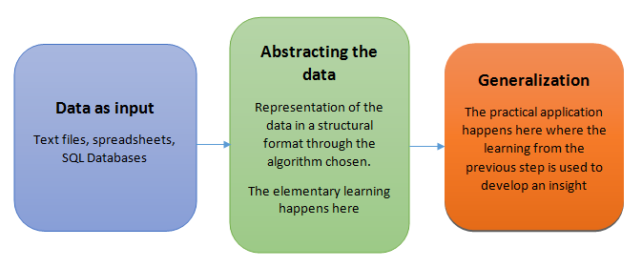
Machine Learning steps
Collecting data
Preparing the data
Training a model : Representation of data in the form of the model. Build a model that is a good and useful approximation to the data
Evaluating the model
Improving the performance : Learning

Slide 16
Application Domains
Web search
Computational biology
Finance
E-commerce
Space exploration
Robotics
Information extraction
Social networks
Language Processing
Many more emerging…
Slide credit: Pedro Domingos

Slide 17
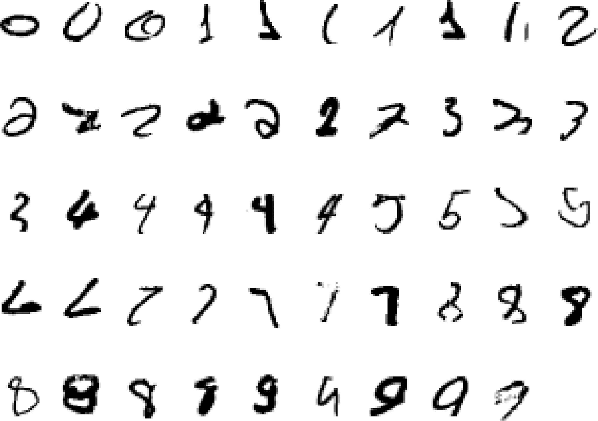
It is very hard to say what makes a 2
Pattern recognition
Slide credit: Geoffrey Hinton

Slide 18
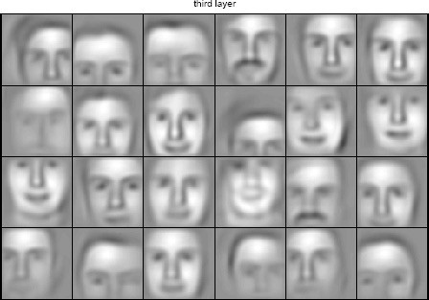
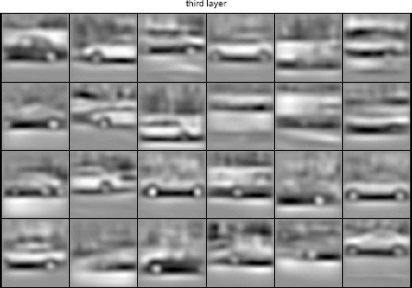
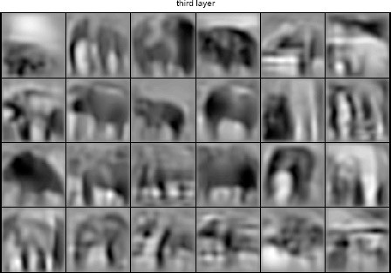
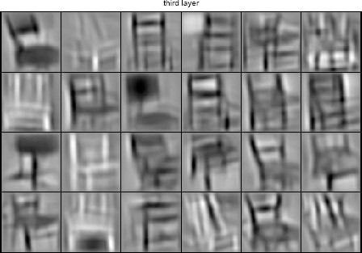
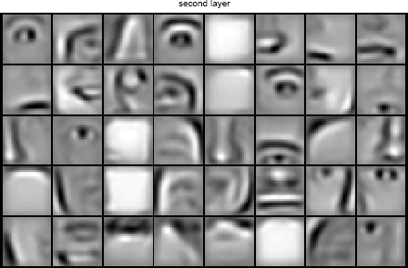
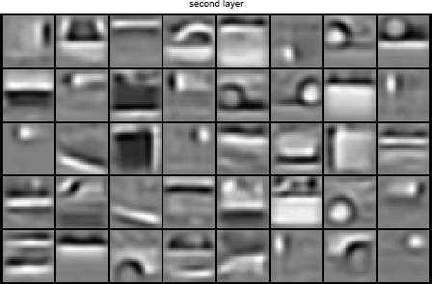
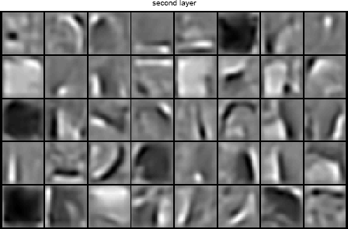
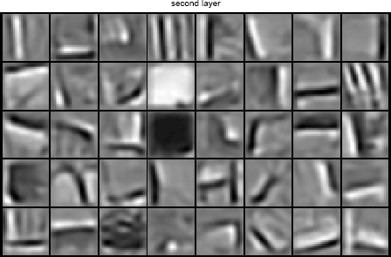
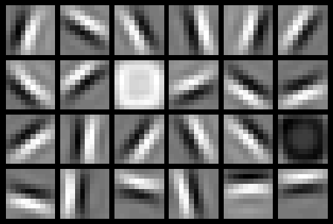
Learning of Object Parts
Slide credit: Andrew Ng

Slide 19
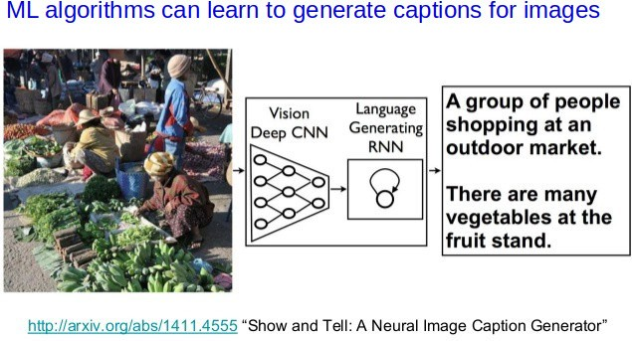
Image Captioning
Slide Credit: Piyush Rai

Slide 20
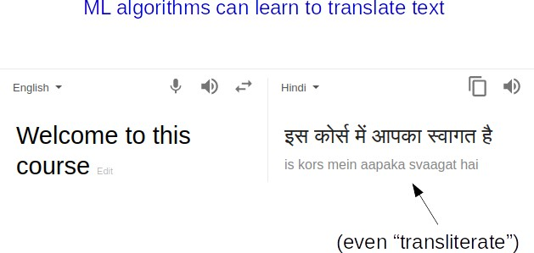
Natural Language Processing
Slide Credit: Piyush Rai

Slide 21
ML as a Learning System

Slide 22






Designing a Learning System
Choose the training experience(data)
Choose exactly what is to be learned
– i.e. the target function
Choose how to represent the target function
Choose a learning algorithm to infer the target function from the experience
Training data
Learner
Environment/ Experience
Knowledge
Testing data
Performance Element
Slide Credit: Ray Mooney

Slide 23
Designing a Learning System: An Example
1. Problem Description (Ex: Playing checkers)
2. Choosing the Training Experience (data expressed as features)
3. Choosing the Target Function to be learnt (Ex: deciding next board position
4. Choosing a Representation for the Target Function (design a function as linear etc)
5. Choosing a Function Approximation Algorithm (parameters learning using loss function)
6. Final Design
14 November 2021

Slide 25
Choosing the Training Experience
The type of training experience E available to a system can have significant impact on success or failure of the learning system.

Slide 26
Choosing the Training Experience
One key attribute is whether the training experience provides direct or indirect feedback regarding the choices made by the performance system

Slide 27
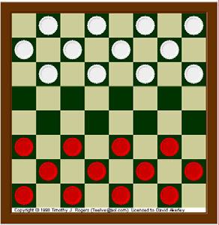
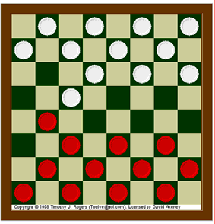
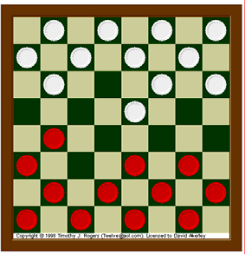
Direct Learning

Slide 28
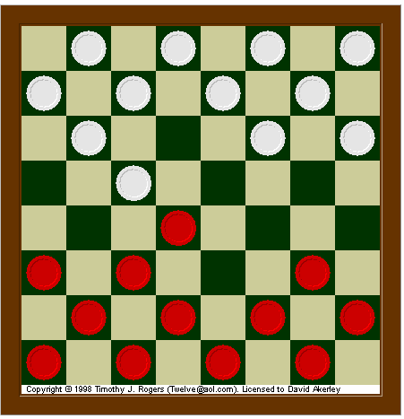
Indirect Learning
Next Move
Win / Loss

Slide 29
Choosing the training experience
In indirect training, information about the correctness of specific moves early in the game must be inferred indirectly from the fact that the game was eventually won or lost.
The learner faces an additional problem of credit assignment, or determining the degree to which each move in the sequence deserves credit or blame for the final outcome.
Credit assignment can be a particularly difficult problem because the game can be lost even when early moves are optimal, if these are followed later by poor moves. Hence, learning from direct training feedback is typically easier than learning from indirect feedback.
14 November 2021

Slide 30
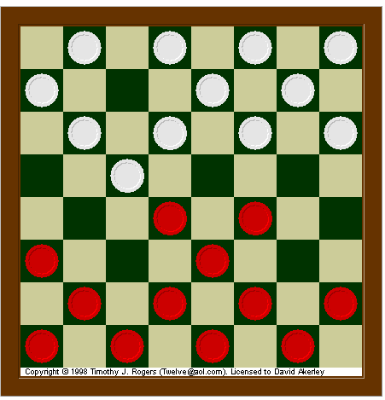
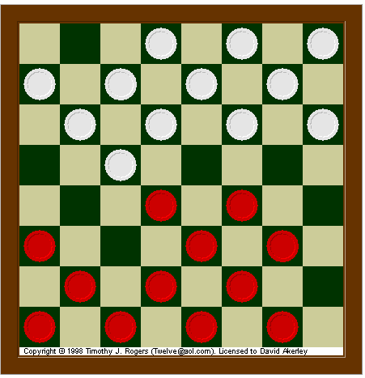
degree to which the learner controls the sequence of training examples.
Choosing the training experience – second attribute
Next Move

Slide 31
Choosing the training experience – second attribute
Teacher / Expert
Player
Next Move
Player
Next Move

Slide 32
Choosing the training experience - third attribute
How well the training experience represents the distribution of examples over which the final system performance P must be measured.
(Learning will be most reliable when the training example follow a distribution similar to that of future test examples)
E.G - the performance metric P is the percent of games the system wins in the world tournament. If its training experience E consists only of games played against itself, there is an obvious danger that this training experience might not be fully representative of the distribution of situations over which it will later be tested.

Slide 33
Assumptions
Let us assume that our system will train by playing games against itself.
And it is allowed to generate as much training data as time permits.

Slide 34
Issues Related to Experience
What type of knowledge/experience should one learn??
How to represent the experience ? (some mathematical representation for experience)
What should be the learning mechanism???

Slide 35

Main objective of the checker playing
Best Next Move

Slide 36
Target Function
Choose Move: B → M
Choose Move is a function
where input B is the set of legal board states and produces M which is the set of legal moves

Slide 37
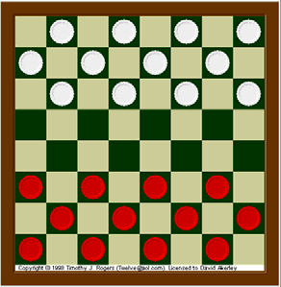
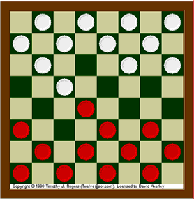
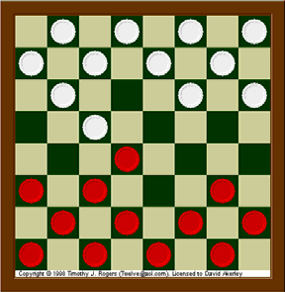
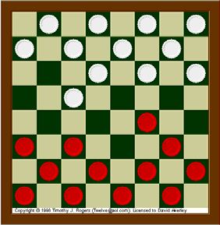
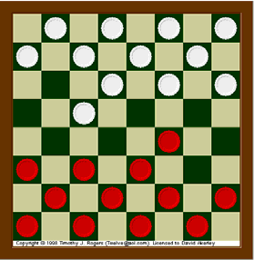
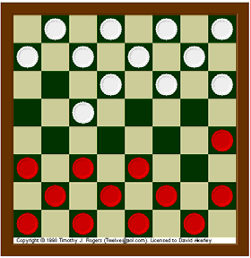
Input: Board State
Output: M (Moves)

Slide 38
Target Function
Choose Move: B → M
M = Choose Move (B)
ChooseMove, is difficult to learn directly.

Slide 39
Alternative Target Function
V : B → R
V is the target function,
Input B is the board state and
Output R denotes a set of real number
An easier and related target function to learn is function V: B --> R, which assigns a numerical score to each board. The better the board positions B, the higher the score R.

Slide 40
Input: Board State
Output: M (Moves)
V = 10
V= 7.7
V = 14.3
V = 10
V = 10.8
V = 6.3
V = 9.4

Slide 41
Choosing the Target Function
Let us therefore define the target value V(b) for an arbitrary board state b in B, as follows:
If b is a final board state that is won, then V(b) = 100
If b is a final board state that is lost, then V(b) = -100
If b is a final board state that is draw, then V(b) = 0
If b is a not a final state in the game, then V(b) = V(b’), where b' is the best final board state that can be achieved starting from b and playing optimally until the end of the game.
14 November 2021

Slide 42
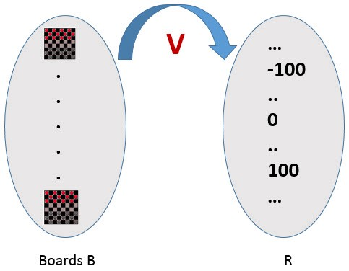
Choosing the Target Function

Slide 43
Choosing the Target Function
Reduced the learning task to the problem of discovering an operational description of the ideal target function V – it is difficult to learn V perfectly.
We often expect learning algorithms to acquire only some approximation to the target function -- is called function approximation. [The actual function can often not be learned and must be approximated]
14 November 2021

Slide 44
Choosing a Representation for the Target Function
Expressiveness versus Training set size
More expressive the representation of the target function, the closer to the “truth” we can get.
More expressive the representation, the more training examples are necessary to choose among the large number of “representable” possibilities.
Example of a representation:
x1 = # of red pieces on the board, x2 = # of black pieces on the board
X3= # of black king on the board
x4 = # of red king on the board
X5 = # of black pieces threatened by black
x6 = # of red pieces threatened by black
V(b) = w0+w1.x1+w2.x2+w3.x3+w4.x4+w5.x5+w6.x6
^
wi’s are adjustable
or “learnable”
coefficients
14 November 2021

Slide 45
Choosing a Representation for the Target Function
Task T: playing checkers
Performance measure P: % of games won in the world tournament
Training experience E: games played against itself
Target function: V : Board → R
Target function representation
V'(b) = w0 + w1x1+ w2x2 + w3x3 + w4x4 + w5x5 + w6x6
The problem of learning a checkers strategy reduces to the problem of learning values for the coefficients w0 through w6 in the target function representation

Slide 46
Choosing a Function Approximation Algorithm
Generating Training Examples of the form <b,Vtrain(b)> [e.g. <x1=3, x2=0, x3=1, x4=0, x5=0, x6=0, +100 (=blacks won)]
x1= # of black pieces on the board
x2 = # of red pieces on the board
x3 = # of black king on the board
x4 = # of red king on the board
x5 = # of black pieces threatened by red
x6 = # of red pieces threatened by black
30 August 2020

Slide 47
Types of Learning
Supervised (inductive) learning
Given: training data, desired outputs (labels)
Unsupervised learning
Given: training data (without desired outputs)
Semi-supervised learning
Given: training data + a few desired outputs
Reinforcement learning
Given: rewards from sequence of actions
Slide Credit: Eric Eaton

Slide 48


















Unsupervised Learning
Given x₁, x₂, ..., x_{n} (without labels)
Output hidden structure behind the x’s
– E.g., clustering
Slide Credit: Eric Eaton

Slide 49
A Typical Unupervised Learning Workflow (for Clustering)
Slide Credit: Piyush Rai

Slide 50
Reinforcement Learning
No predefined data
Semi-supervised learning model in machine learning,
Allow an agent to take actions and interact with an environment so as to maximize the total rewards.
Examples:
Resources management in computer clusters
Game playing
Robot in a maze
Slide Credit: Eric Eaton

Slide 51
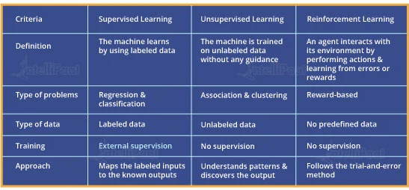
Supervised, Unsupervised and Reinforcement Learning Comparison

Slide 52
Supervised (inductive) learning

Slide 53
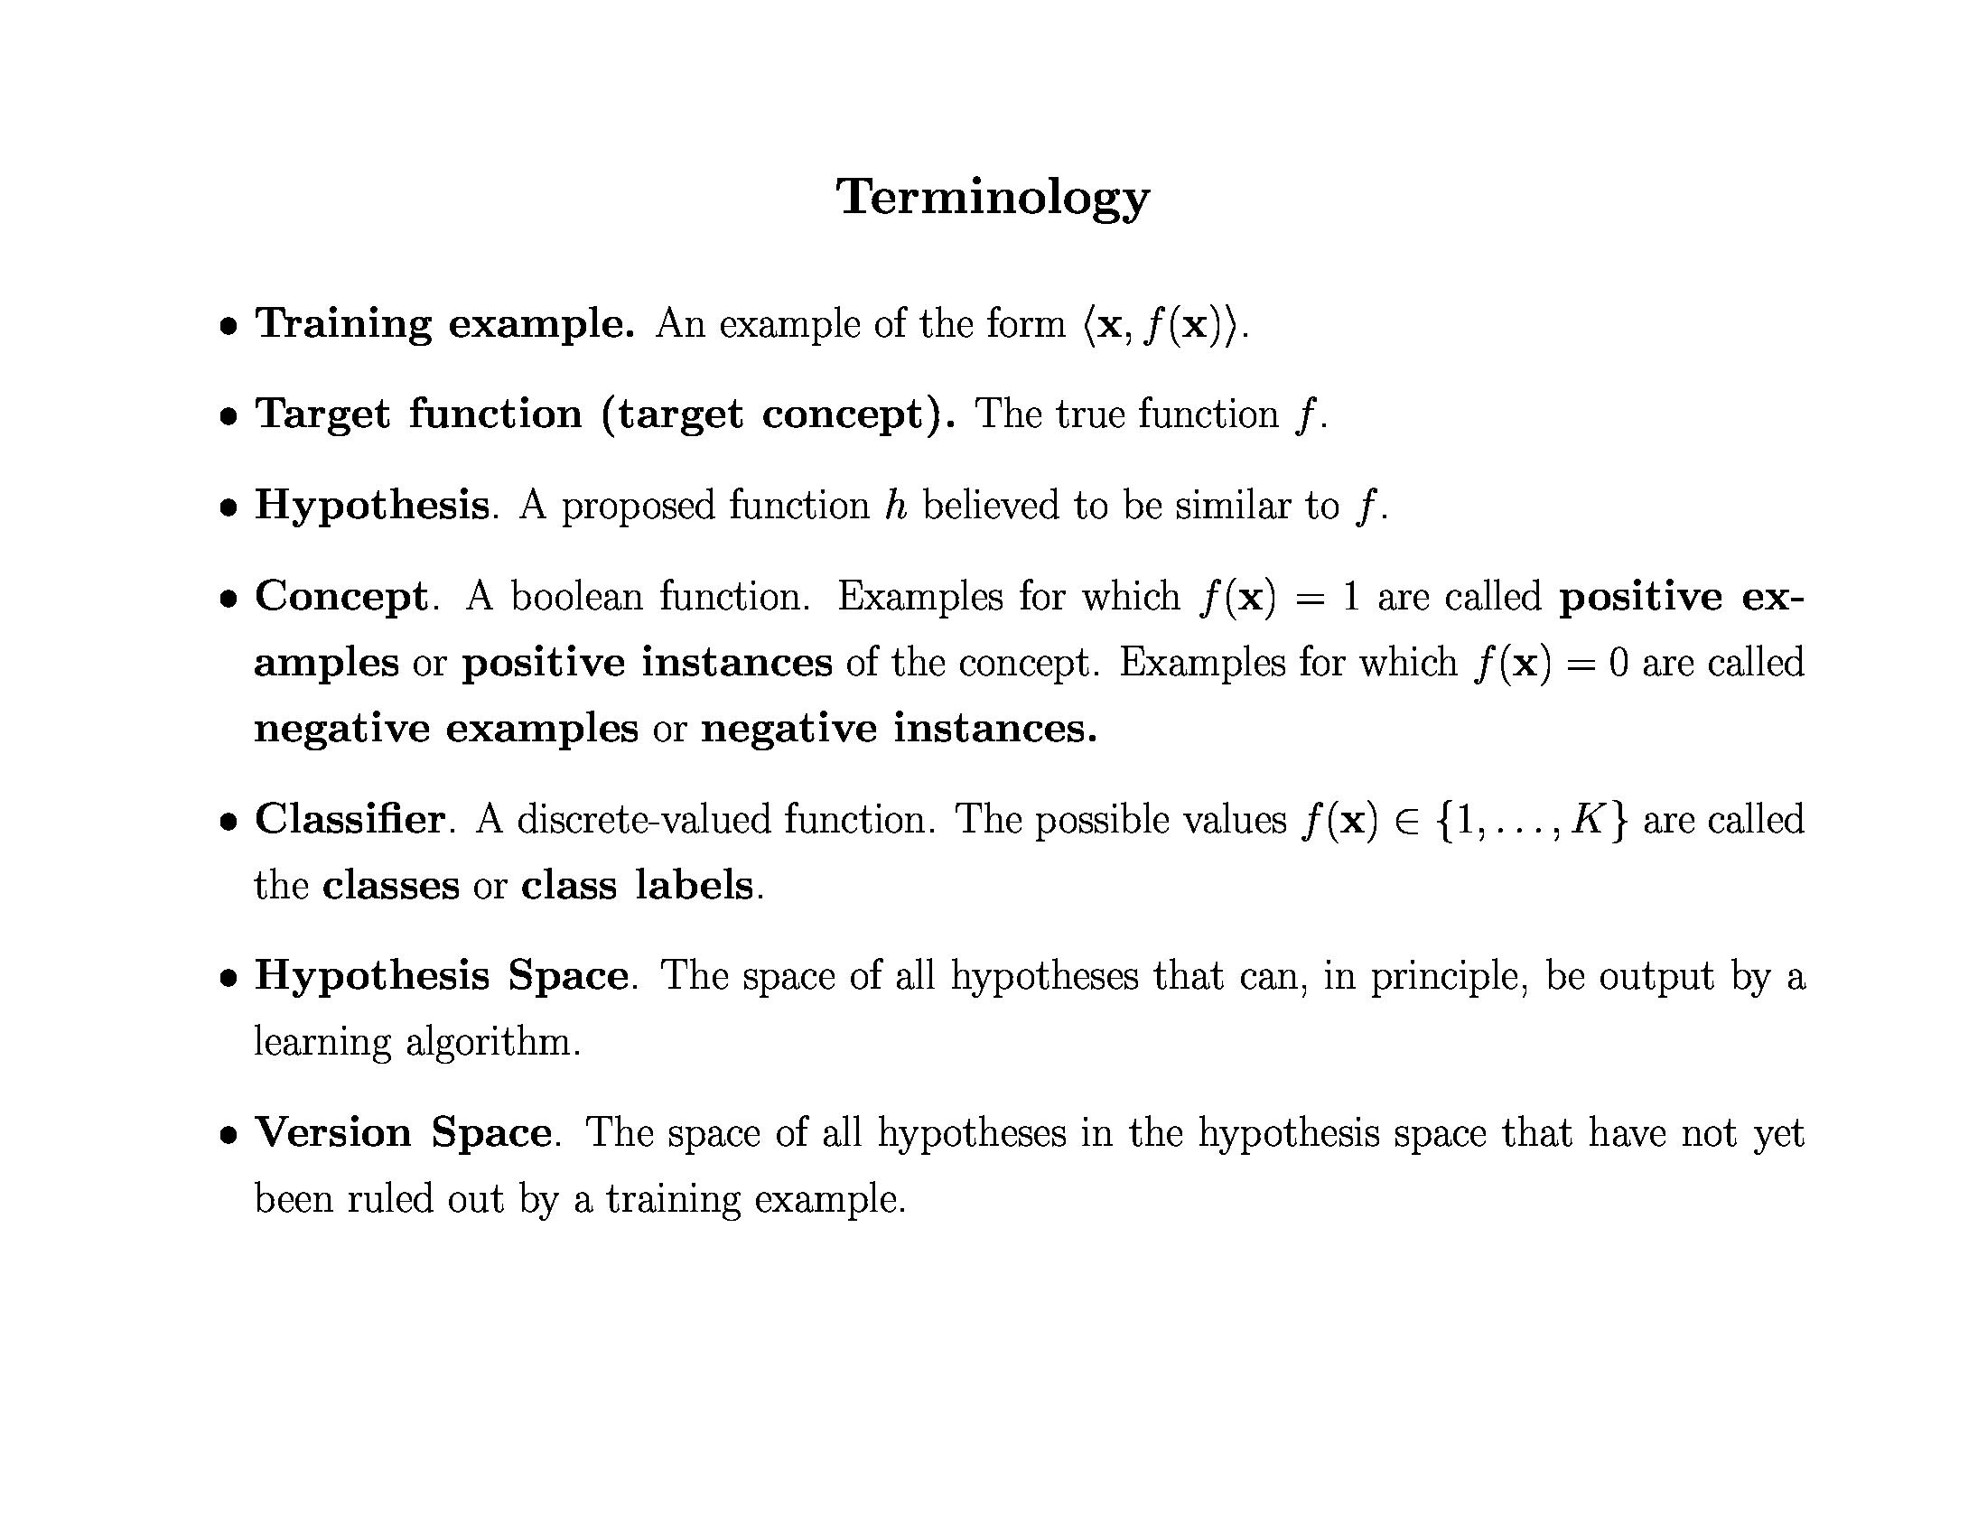

Slide 54
Inductive Learning Hypothesis
Any hypothesis found to approximate the target function well over a sufficiently large set of training examples will also approximate the target function well over other unobserved examples

Slide 55
Inductive Learning
Inductive learning or “Prediction”:
Given examples of a function (X, F(X))
Predict function F(X) for new examples X
Classification
F(X) = Discrete
Regression
F(X) = Continuous
Probability estimation
F(X) = Probability(X):

Slide 56
Learning a Class from Examples
Class C of a “family car”
Prediction: Is car x a family car?
Knowledge extraction: What do people expect from a family car?
Output:
Positive (+) and negative (–) examples
Input representation:
x₁: price, x₂ : engine power

Slide 57
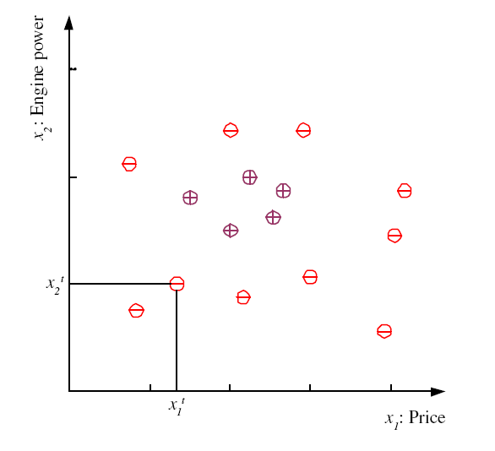
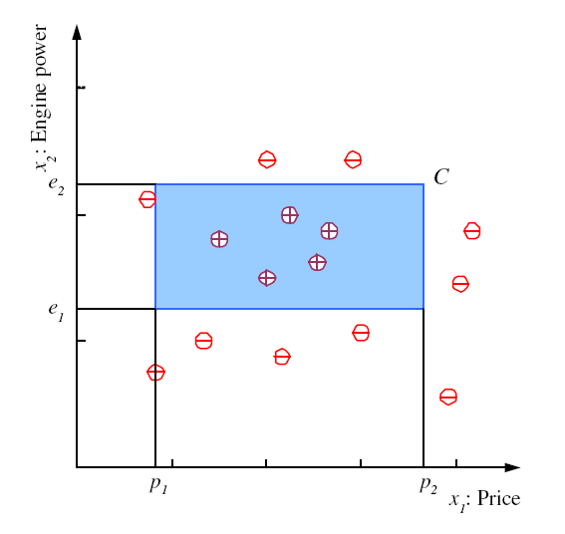
Training set X
Class C

Slide 58
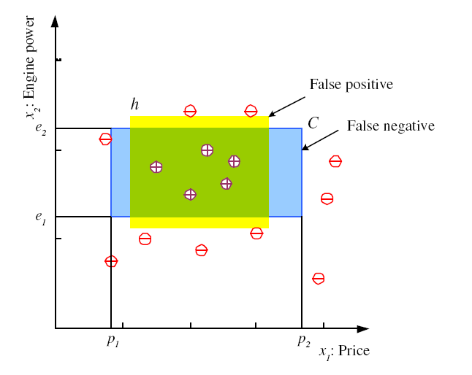
Hypothesis class H

Slide 59
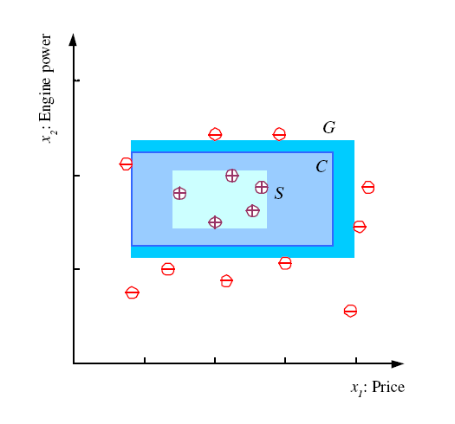
S, G, and the Version Space
most specific hypothesis, S
h ∈ H, between S and G is consistent and make up the version space
most general hypothesis, G
A hypothesis h is consistent with a set of training examples D of target concept c
The version space, with respect to hypothesis space H and training examples D, is the subset of hypotheses from H consistent with D

Slide 60
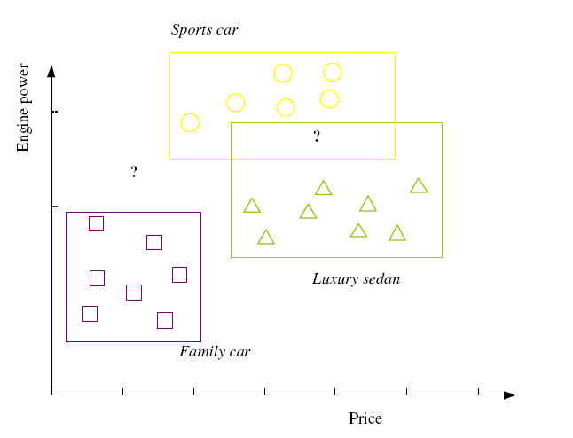
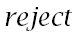
Multiple Classes, Ci i=1,...,K

Slide 61
Empirical Error
C = actual class
h = induced hypothesis.
false negative =->C is 1 but h is 0
false positive -> C is 0 but h is 1

Slide 62
Empirical Error
C(x) -> unknown , we cannot evaluate how well h(x) matches C(x).
The empirical error is the proportion of training instances where predictions of h do not match the required values given in X.
In our example, the hypothesis class H is the set of all possible rectangles.

Slide 63
Noise
Imprecision in recording the
input attributes
Errors in labeling the data points
Additional hidden/latent attributes
that affect the label of an instance

Slide 64




Supervised Learning: Regression
Given (x₁, y₁), (x₂, y₂), ..., (x_{n}, y_{n})
Learn a function f(x) to predict y given x
9
8
7
6
5
4
3
2
1
0
1970 1980
September Arctic Sea Ice Extent (1,000,000 sq km)
1990
2000
2010
2020
Year
Data from G. Witt. Journal of Statistics Education, Volume 21, Number 1 (2013) Slide Credit: Eric Eaton

Slide 65
Regression
y = f(x)
Training: given a training set of labeled examples {(x₁,y₁), …, (x_{N},y_{N})}, estimate the prediction function f by minimizing the prediction error on the training set
Testing: apply f to a never before seen test example x and output the predicted value y = f(x)
output
prediction function
features
Slide credit: L. Lazebnik

Slide 66
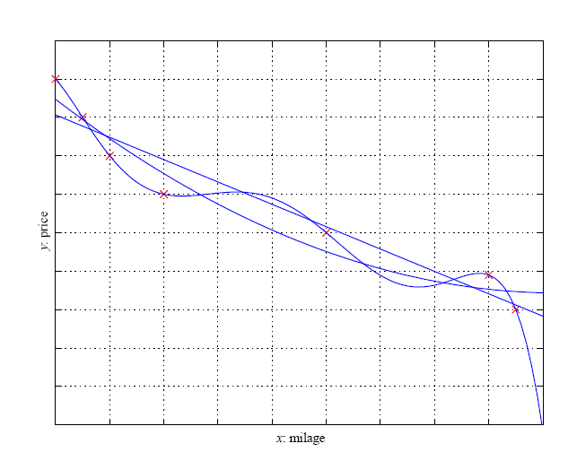
Regression

Slide 67
Inductive Bias
Learning is an ill-posed problem; data is not sufficient to find a unique solution
Need to make assumptions
Experience alone doesn’t allow us to make conclusions about unseen data instances
Inductive bias
The set of assumptions we make to have learning possible is called the inductive bias of the learning algorithm
The need for inductive bias, assumptions about H

Slide 68
Inductive Bias
Two types of bias:
Restriction: Limit the hypothesis space (e.g., look at rules)
Preference: Impose ordering on hypothesis space (e.g., more general, consistent with data)

Slide 69
Model Selection & Generalization
Learning is not possible without inductive bias, and now the question is how to choose the right bias. This is called model selection: choosing between possible H .
Generalization—that is, how well our hypothesis will correctly classify future examples that are not part of the training set.
Overfitting: H more complex than C or f
Underfitting: H less complex than C or f

Slide 70
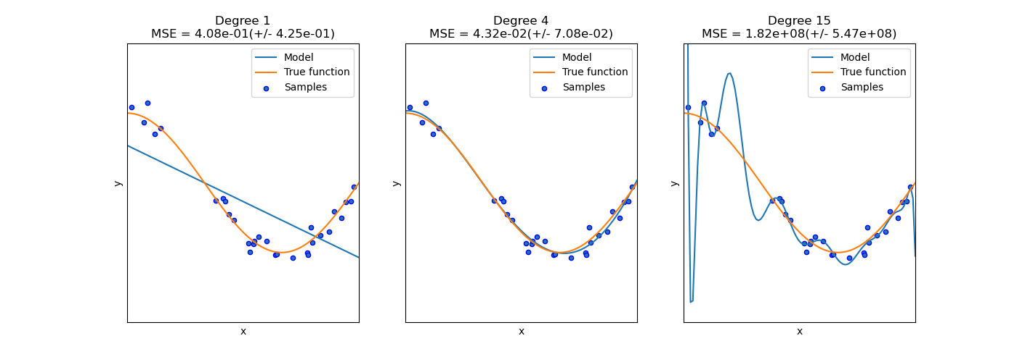
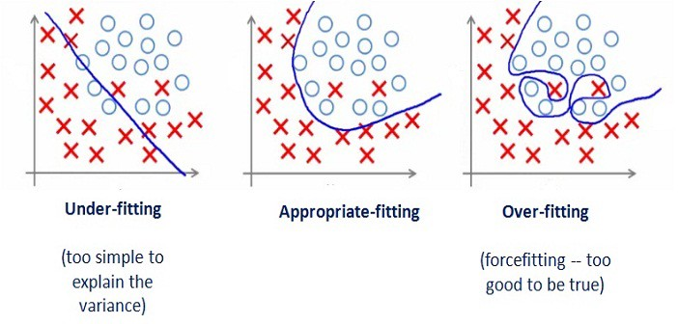
Overfitting/Underfitting

Slide 71
Triple Trade-Off
There is a trade-off between three factors (Dietterich, 2003):
Complexity of H, c (H),
Training set size, N,
Generalization error, E, on new data
As N increases, E↓
As c (H) increases, first E↓ and then E increases

Slide 72
Cross-Validation
To estimate generalization error (measure the quality of inductive bias), we need data unseen during training. We split the data as
Training set
Validation set
Test (publication) set
Resampling when there is few data
cross-validation : choosing the hypothesis that is the most accurate on the validation set is the best one (the one that has the best inductive bias)

Slide 73
Training vs Testing
What do we want?
High accuracy on training data?
No, high accuracy on unseen/new/test data!
Why is this tricky?
Training data
Features (x) and labels (y) used to learn mapping f
Test data
Features used to make a prediction
Labels only used to see how well we’ve learned f!!!
Validation data
Held-out set of the training data
Can use both features and labels to tune parameters of the model we’re learning

Slide 74
Training vs. Test Distribution
We generally assume that training and test examples are independently drawn from the same overall distribution of data
– We call this “i.i.d” which stands for “independent and identically distributed”
Slide credit: Ray Mooney

Slide 75
Issues in Machine Learning
What algorithms are available for learning a concept? How well do they perform?
How much training data is sufficient to learn a concept with high confidence?
When is it useful to use prior knowledge?
Are some training examples more useful than others?
What are the best tasks for a system to learn?
What is the best way for a system to represent its knowledge?
14 November 2021

Slide 76
ML in a Nutshell
Tens of thousands of machine learning algorithms
Hundreds new every year
Every ML algorithm has three components
Representation
Optimization
Evaluation
Slide credit: Pedro Domingos

Slide 77
Evaluation
Accuracy
Precision and recall
Squared error
Likelihood
Posterior probability
Cost / Utility
Margin
Entropy
etc.
Slide credit: Pedro Domingos

Slide 78
Evaluating Performance
If y is discrete:
Accuracy: # correctly classified / # all test examples
Good for class balanced dataset
Want evaluation metric to be in some range, e.g. [0 1]
0 = worst possible classifier, 1 = best possible classifier

Slide 79
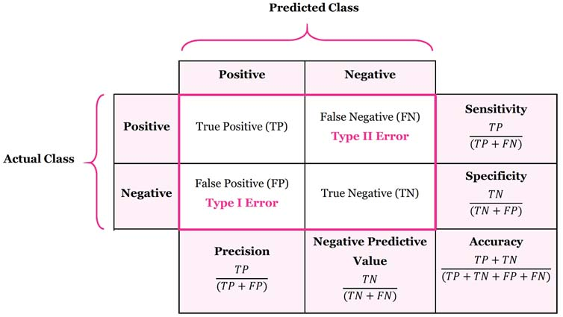
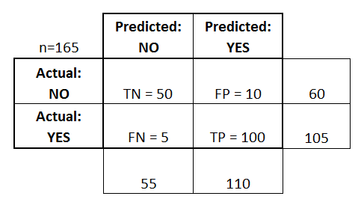
Confusion matrix

Slide 80
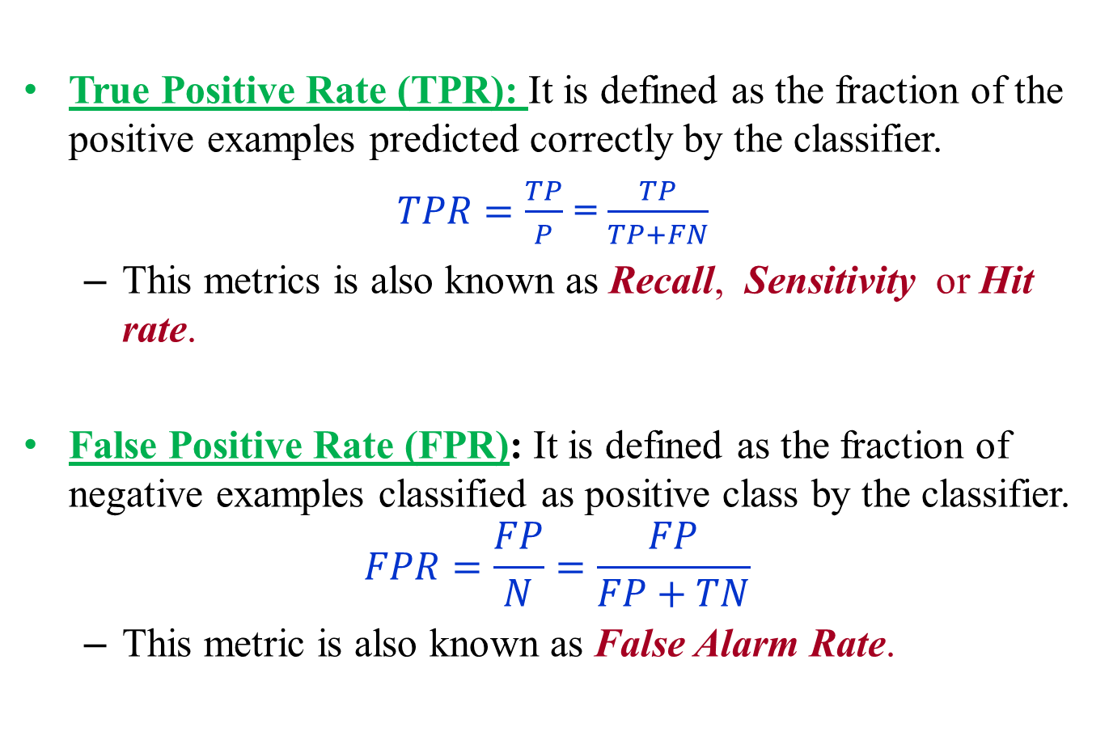
Evaluating Performance
True Positive Rate (TPR): It is defined as the fraction of the positive examples predicted correctly by the classifier.
$TPR=\frac{TP}{P}$ = $\frac{TP}{TP+FN}$
This metrics is also known as Recall, Sensitivity or Hit rate.
False Positive Rate (FPR): It is defined as the fraction of negative examples classified as positive class by the classifier.
$$FPR=\frac{FP}{N}=\frac{FP}{FP+TN}$$
This metric is also known as False Alarm Rate.

Slide 81
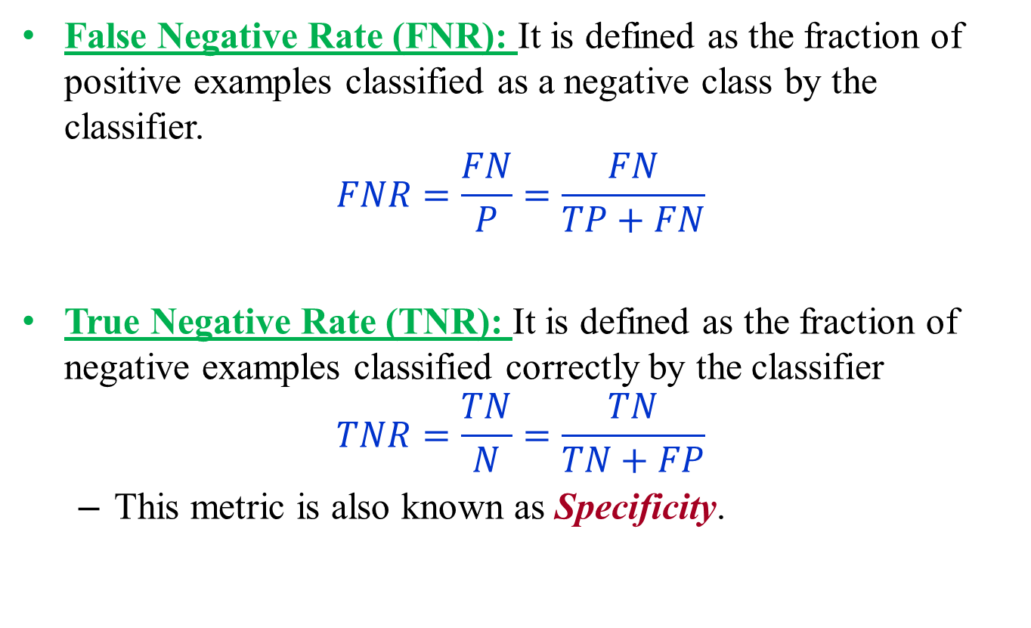
Evaluating Performance
False Negative Rate (FNR): It is defined as the fraction of positive examples classified as a negative class by the classifier.
$$FNR=\frac{FN}{P}=\frac{FN}{TP+FN}$$
True Negative Rate (TNR): It is defined as the fraction of negative examples classified correctly by the classifier
$$TNR=\frac{TN}{N}=\frac{TN}{TN+FP}$$
This metric is also known as Specificity.

Slide 82
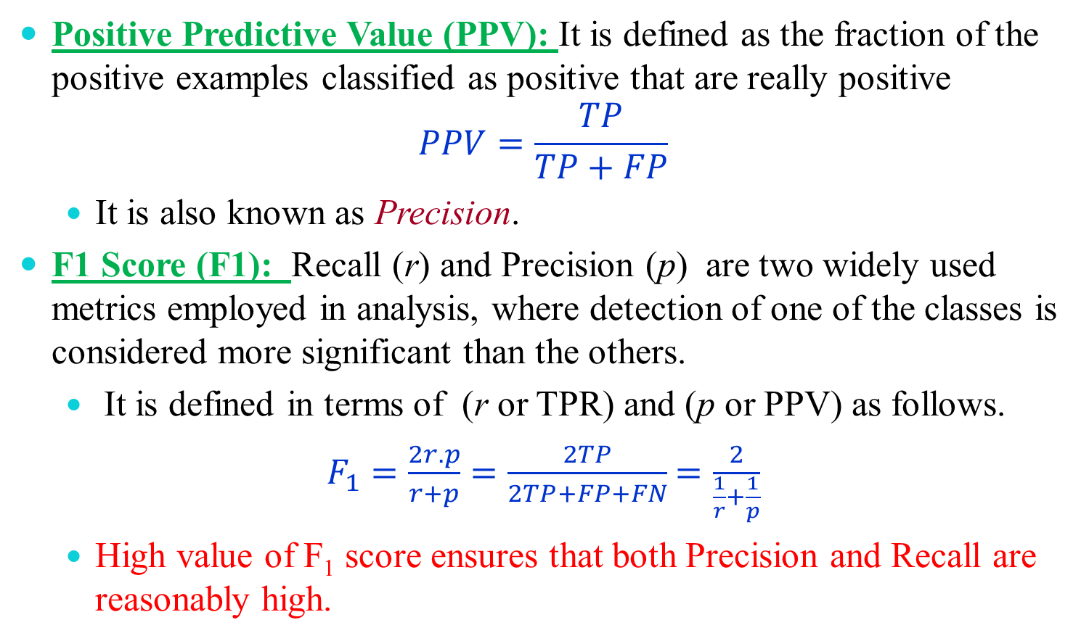
Evaluating Performance
Positive Predictive Value (PPV): It is defined as the fraction of the positive examples classified as positive that are really positive
$$PPV=\frac{TP}{TP+FP}$$
It is also known as Precision.
F1 Score (F1): Recall (r) and Precision (p) are two widely used metrics employed in analysis, where detection of one of the classes is considered more significant than the others.
It is defined in terms of (r or TPR) and (p or PPV) as follows.
$F_{1}=\frac{2r.p}{r+p}=\frac{2TP}{2TP+FP+FN}$ $=\frac{2}{\frac{1}{r}+\frac{1}{p}}$
High value of F₁ score ensures that both Precision and Recall are reasonably high.

Slide 83
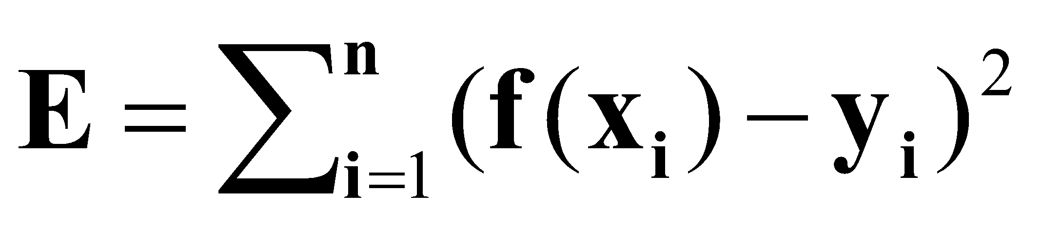
Evaluating Performance
If y is continuous:
Sum-of-Squared-Differences (SSD) error between predicted and true y:

Slide 84


ML in Practice
Understand domain, prior knowledge, and goals
Data integration, selection, cleaning, pre-processing, etc.
Learn models
Interpret results
Consolidate and deploy discovered knowledge
Loop
Based on a slide by Pedro Domingos

Slide 85
Thank you !

